Slide 1
IBM HACK CHALLENGE
Project AI Recruiter
Team Name Moody Amygdala
Team Members Ayushi Asthana
Dnyanraj Dhamne

Slide 2
Module 1
Registration:
In this form we are taking the basic information of user
Login:
Login page to login for userusing there mail_id
Application:
In this application form we are taking information about the technical skills of applicant .

Slide 3
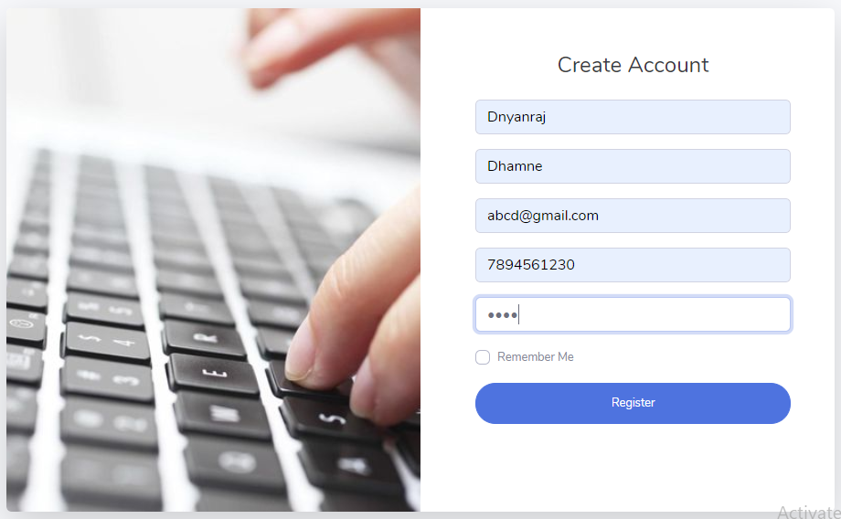
Registration
Registration:
In this form we are taking the basic information of user

Slide 4
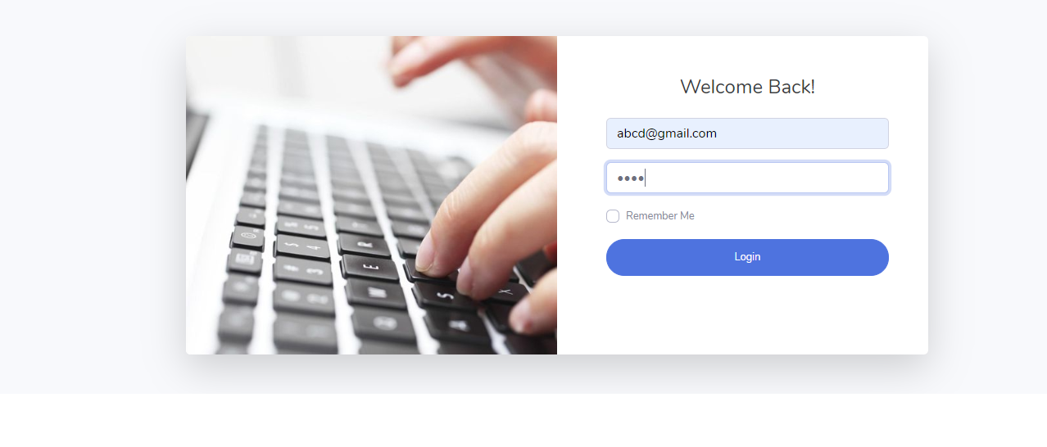
Login
Login:
Login page to login for user
using there mail_id

Slide 5
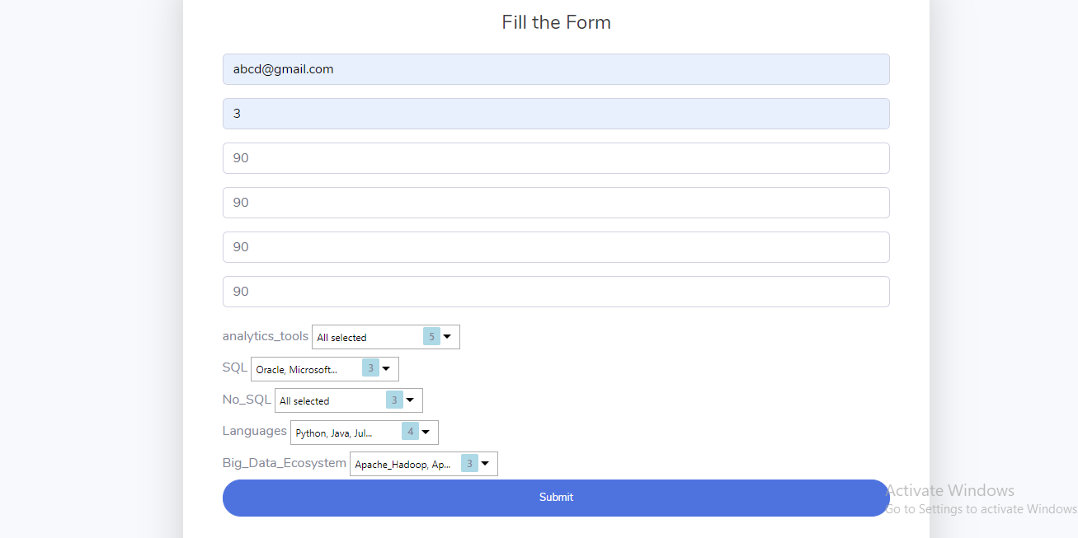
Application Form
Application :
In this application form we are taking information about the technical skills of applicant .

Slide 6
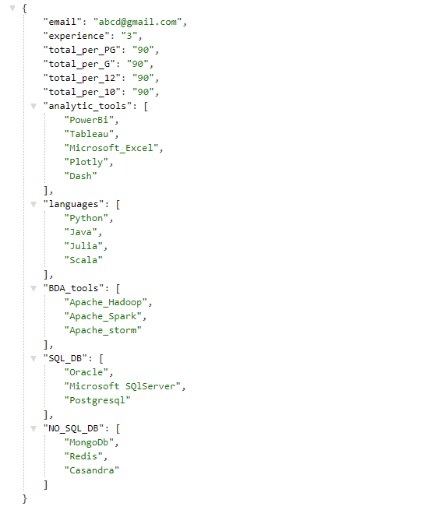
Json document
This json document get created after the applicant fill the application form
This json data will go to our python script for 1st level of shortlisting .

Slide 7
Module 2
Assistant’s:-
1) FAQs-
It will answer the applicants questions about job role interview process
2) Interview-
It will take the interview of the applicants who passed the first level of shortlisting.

Slide 8
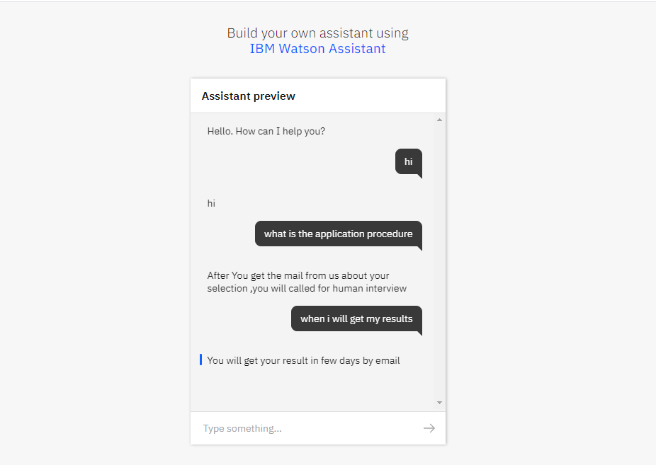
FAQ Assistant
FAQs-
It will answer the applicants questions about job role interview process
Preview link for FAQ chatbot: https://web-chat.global.assistant.watson.cloud.ibm.com/preview.html?region=eu-gb&integrationID=66d920ef-b197-4b2f-8495-fba1679e2198&serviceInstanceID=4ff9c732-7672-4426-aebc-6ed6b1945f52

Slide 9
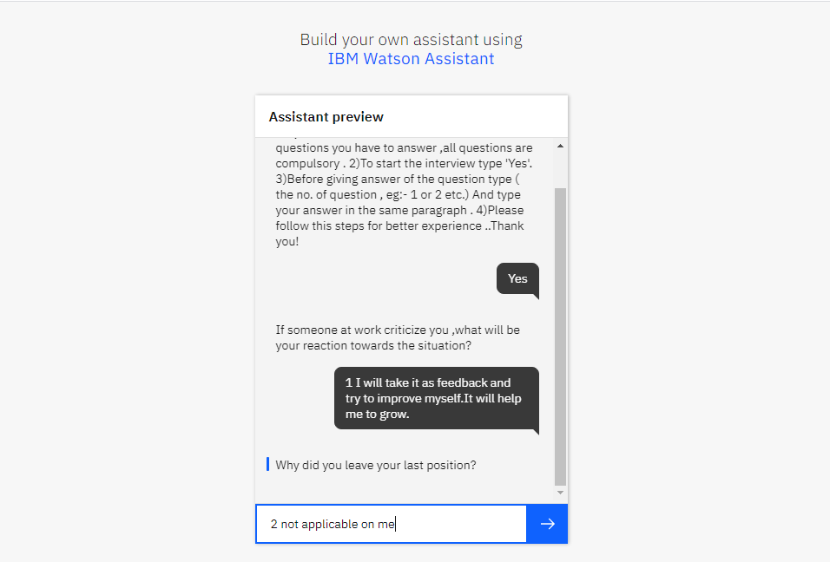
Interview Assistant
Interview-
It will take the interview of the applicants who passed the first level of shortlisting .
Preview link for Interview Chatbot: https://web-chat.global.assistant.watson.cloud.ibm.com/preview.html?region=eu-gb&integrationID=a99ed292-9d7f-4551-ae5e-da3726514842&serviceInstanceID=4ff9c732-7672-4426-aebc-6ed6b1945f52

Slide 10
Module 3
First Level Shortlisting
Applicants application data will be fetched and applicants are shortlist on the basis of criteria specified by the domain expert or the company.
The applicants who cleared this round will give bot interview

Slide 11
Module 4
Second Level Shortlisting
The Interview data from assistant will be fetched and it is then given to personality insight.
Personality insight will give the profile of the applicant, this profile is the mapped to the traits requirement given by the domain expert.
Applicants who satisfy the requirements will be shortlisted for human interview

